Slide 1

Webathon 2.0
Team Name : Team_10
K Sai Priya 23075A3203
K Shivani 23075A3204
M Deepthi Sri 23075A3205
L Abhilesh 22071A1225
Karthik 22071A1233

Slide 2
Problem Statement
This website is a sophisticated web-based library management system crafted to streamline operations, enhance resource accessibility, and elevate the user experience for patrons and staff alike. By leveraging innovative technology, It should revolutionize traditional library management, making library services more efficient and user-centric.

Slide 3
Features:
Dynamic Catalog System: Implement an intuitive and searchable catalog system enabling users to easily discover library resources such as books, journals, articles, and multimedia materials through various search parameters including title, author, keyword, or subject.
User Account Management: Enable patrons to create and manage their accounts for tasks such as borrowing renewals, resource reservations, and viewing account status. Integrate self-service functionalities for seamless user interactions and increased convenience.
Staff Dashboard and Analytics: Provide a centralized staff dashboard with comprehensive management tools to oversee library operations efficiently. Staff can manage resources, track circulation activities, generate detailed reports on resource usage, and monitor overdue items for proactive management.

Slide 4
Automated Notifications: Implement automated notification systems to alert patrons about upcoming due dates, overdue items, and reserved resources ready for pickup. This feature enhances user engagement and helps ensure the timely return of borrowed materials.
Integration with Library Systems: Seamlessly integrate with existing library systems and databases to facilitate efficient data exchange and interoperability. This ensures smooth transition and compatibility with established library workflows, maximizing system usability and effectiveness.
Gmail verification using OTP.
Showing overdue and on time on a pie chart.
Online books and offline books.

Slide 5

Screenshots:
OTP Verification:

Slide 6

Home page:

Slide 7
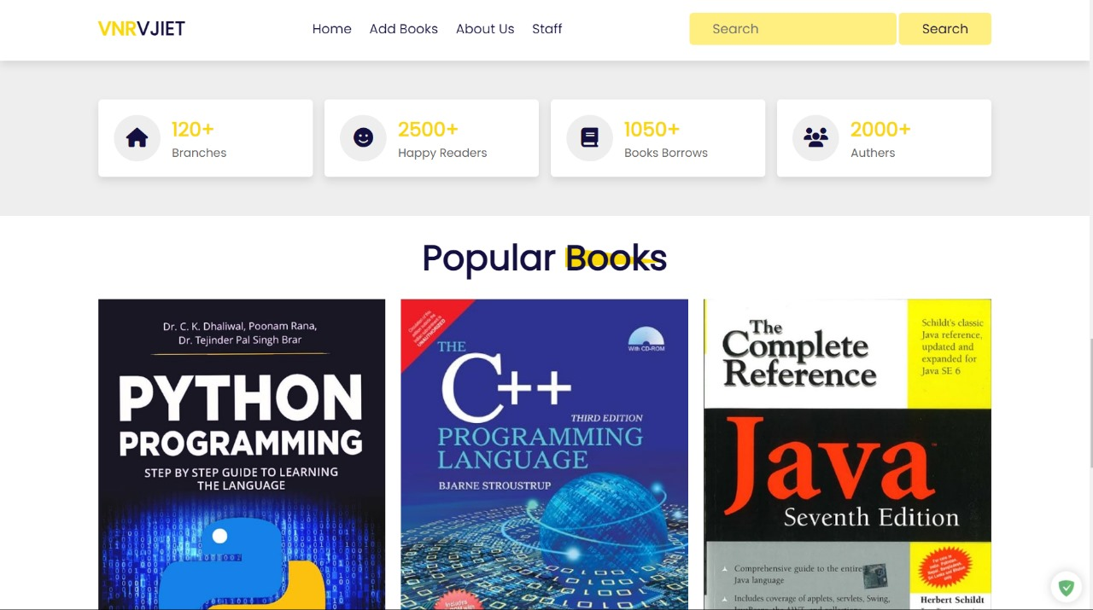

Slide 8
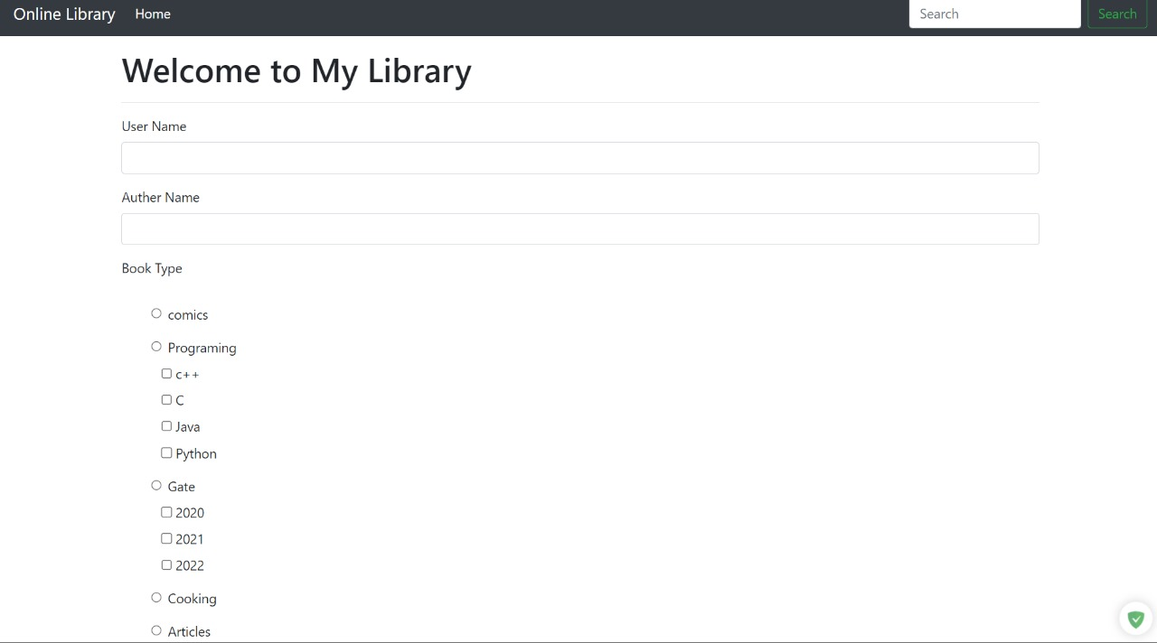
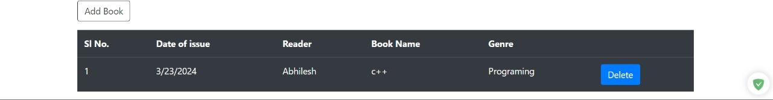

Slide 9
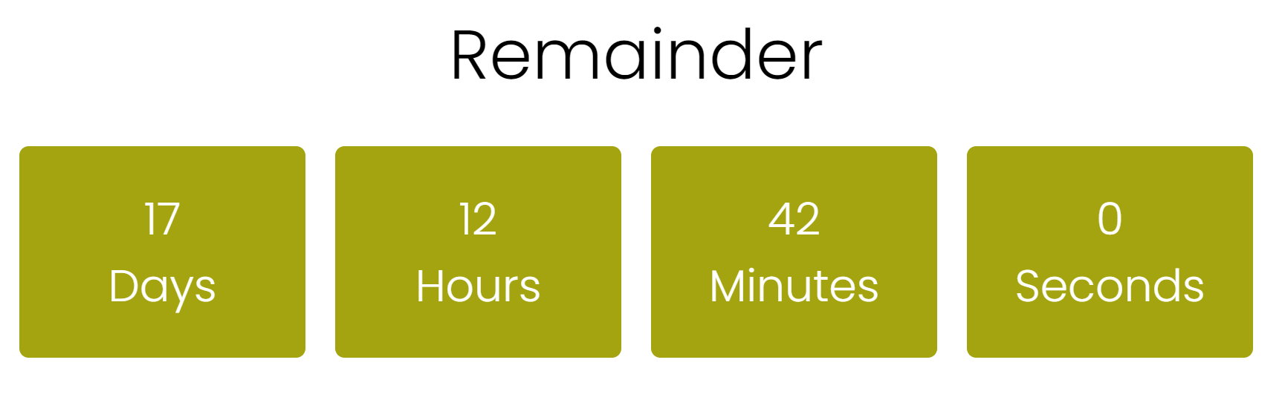

Slide 10
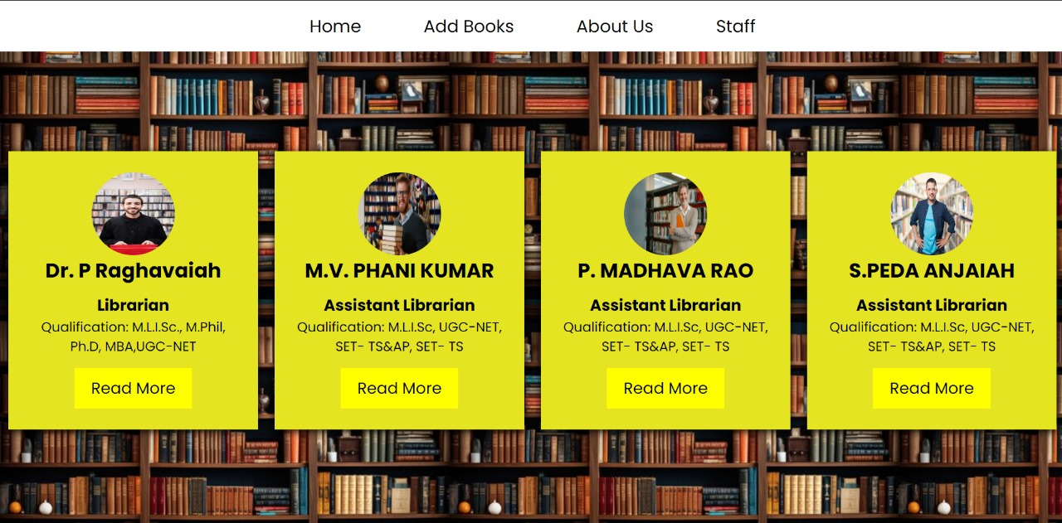
Staff Page:

Slide 11
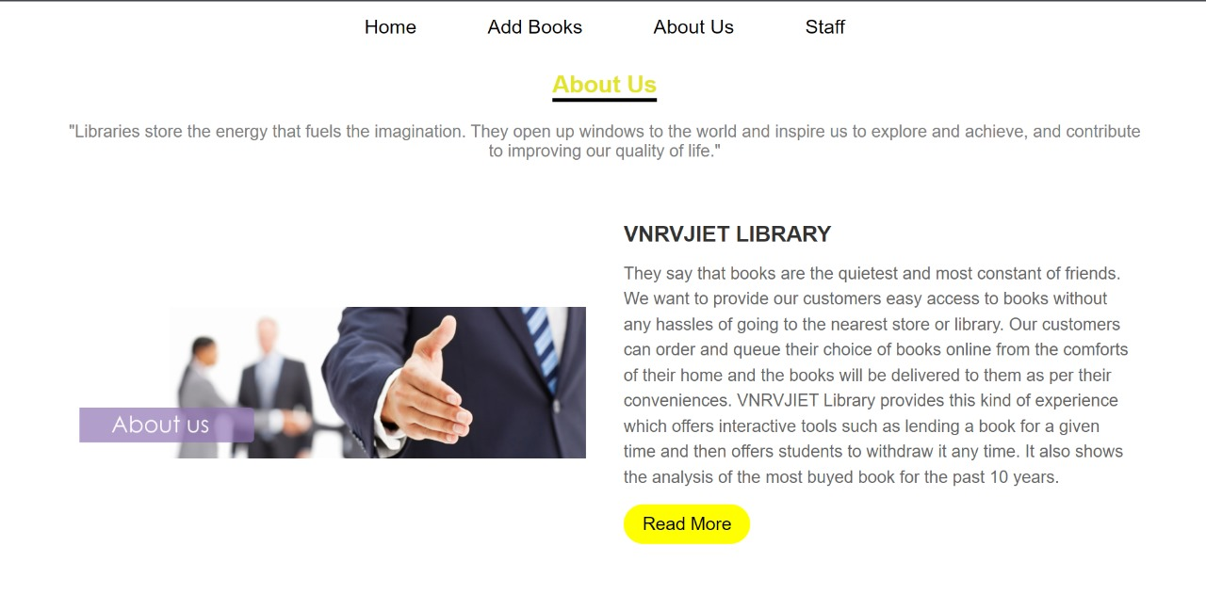
About Us:

Slide 12
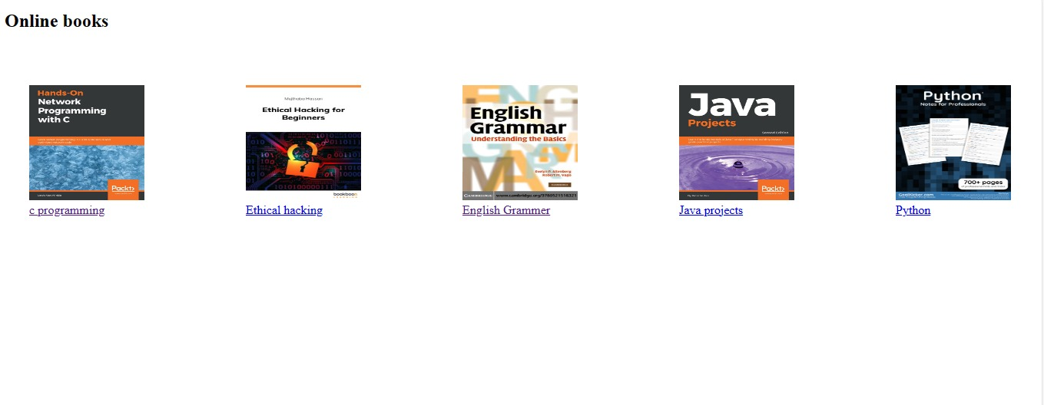
Books:

Slide 13
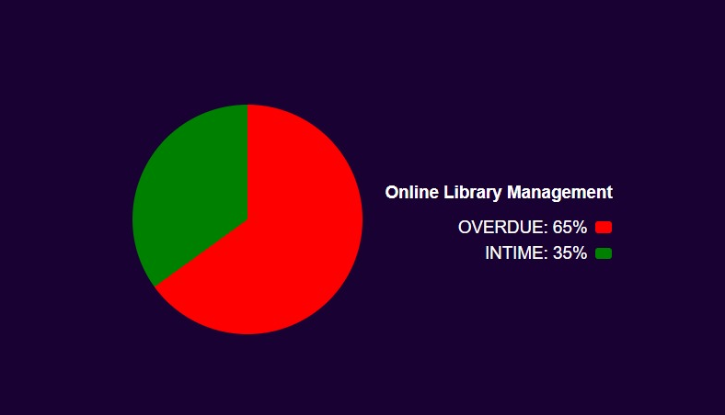

Slide 14
Tech Stack
Frontend :- HTML and CSS and Java-script
2. Backend :-
a) Python..
b) Express.js (Node.js) for building the backend API.
c) OAuth or JWT for secure user authentication and authorization.
3. Database :-
a) MongoDB or MySQL for relational databases due to the structured nature of data.

Slide 15
Thank you!!

